Slide 1
  本讲内容
序列模式
  序列模式简介
  GSP算法
  PrefixSpan算法

Slide 2
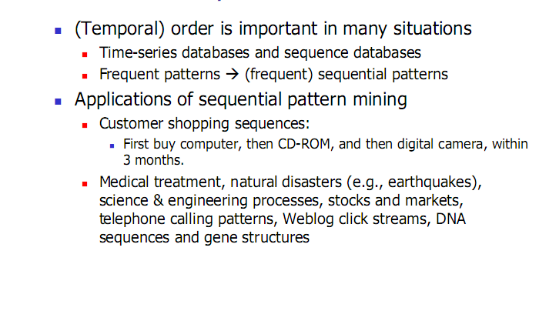
序列模式简介

Slide 3
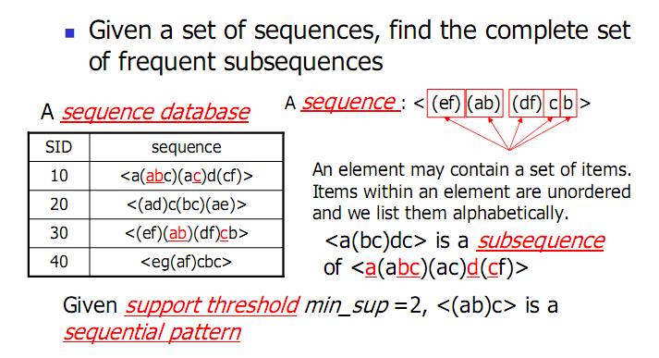
序列模式简介

Slide 4
序列模式简介
项目集(Itemset)：是各种项目组成的集合
序列(Sequence)：是不同项目集(ItemSet)的有序排列，序列s可以表示为s = <s₁s₂…s_{l}>，s_{j}(1 <= j <= l)为项目集(Itemset)，也称为序列s的元素
序列的长度：一个序列所包含的项目集(ItemSet)的个数。

Slide 5
序列模式简介
设α = <a₁a₂…a_{n}>，β = <b₁b₂…b_{m}>，如果存在整数1 <= j₁ < j₂ <…< j_{n} <= m，使得a₁ ⊆ b_{j1}，a₂ ⊆ b_{j2}，…， a_{n} ⊆ b_{jn}，则称序列α为序列β的子序列，又称序列β包含序列α，记为α ⊆ β
  例如，序列<(3)(4 5)(8)>是序列<(7)(3 8)(9)(4 5 6)(8)>的子序列。
  但，<(3)(5)>不是<(3 5)>的子序列，反之亦然。
给定一个序列集合，如果序列s不包含于任何一个其它的序列中，则称s是最大的（Maximal Sequence）。

Slide 6
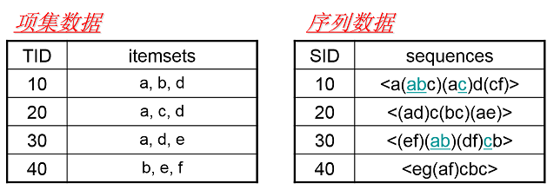
项集与序列
一条项集数据是一个集合，如{a, b, d}，没有顺序关系
一条序列数据是由多个项集依次排成的序列，项集之间有顺序关系
如<a(abc)(ac)d(cf)>表示<{a}{a, b, c}{a, c}{d}{c, f}>
多元项集需加上括号，无括号的字母视作单项集
Notes:
为了方便，序列数据中项集内部按字母顺序排列

Slide 7
子序列
若一条序列T的每个字母都能在S中依次找到对应字母
则称T是S的子序列
如：
<(ab)c>是序列10和30的子序列
<dc>是序列10、20、30的子序列
<abc>是序列10、40的子序列
<cg>不是任何序列的子序列

Slide 8
小练习
<(ab)d>是序列__________的子序列
<cc>是序列_____________的子序列
<aa>，支持度是____, _____频繁序列
<(ad)e>，支持度是____, _____频繁序列

Slide 9
频繁序列
若一条序列T在序列数据集中作为子序列的频率≥α
则称序列T是序列数据集的频繁序列
如：
α称为阈值，可以人为设定
*简单起见，在接下来的所有内容中，α都设为50%
<(ab)c>，50%（10、30）是频繁序列
<ac>，100%（10、20、30、40）是频繁序列
<(cf)>，10%（10）不是频繁序列
<cab>，0%，不是频繁序列
SID | sequence
10 | <a(abc)(ac)d(cf)>
20 | <(ad)c(bc)(ae)>
30 | <(ef)(ab)(df)cb>
40 | <eg(af)cbc>
SID | sequence
10 | <a(abc)(ac)d(cf)>
20 | <(ad)c(bc)(ae)>
30 | <(ef)(ab)(df)cb>
40 | <eg(af)cbc>
SID | sequence
10 | <a(abc)(ac)d(cf)>
20 | <(ad)c(bc)(ae)>
30 | <(ef)(ab)(df)cb>
40 | <eg(af)cbc>
SID | sequence
10 | <a(abc)(ac)d(cf)>
20 | <(ad)c(bc)(ae)>
30 | <(ef)(ab)(df)cb>
40 | <eg(af)cbc>
SID | sequence
10 | <a(abc)(ac)d(cf)>
20 | <(ad)c(bc)(ae)>
30 | <(ef)(ab)(df)cb>
40 | <eg(af)cbc>

Slide 10
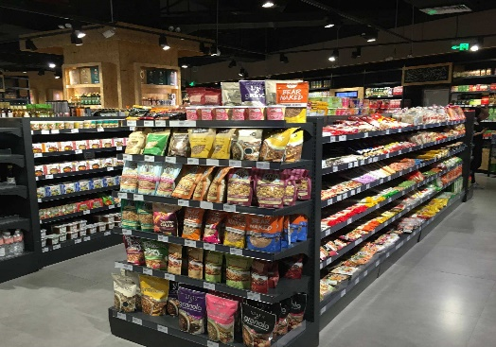

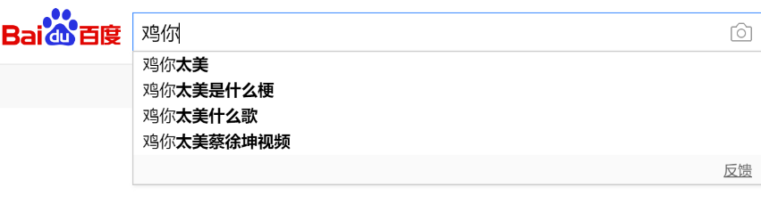
寻找频繁序列
用途：
货架摆放
内容推送
搜索联想
……

Slide 11
序列模式简介
Customer-sequence
  All the transactions of a customer, ordered by increasing transaction-time, corresponds to a sequence.
序列α在序列数据库S中的支持数为序列数据库S中包含序列α的序列个数，记为Support(α)
序列模式挖掘：找出所有最大的频繁子序列。

Slide 12
序列模式简介
itemset的支持度: itemset作为一个整体，在整个数据库中出现的比例，比如，单次购物时同时购买该itemset中所有项目的顾客占全部顾客的百分比
  itemset的支持度 等于 1-sequence的支持度
litemset (Large itemset)：A itemset with minimum support
Candidate sequence
Large sequence

Slide 13
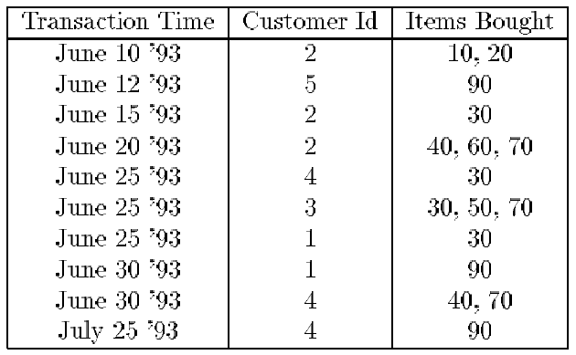
Example
Q. How to find the sequential patterns?

Slide 14
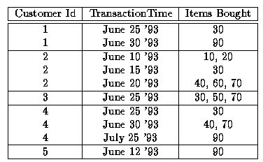
Example
以Customer_Id 及 TransactionTime 排序
Transaction
Item
Itemset

Slide 15
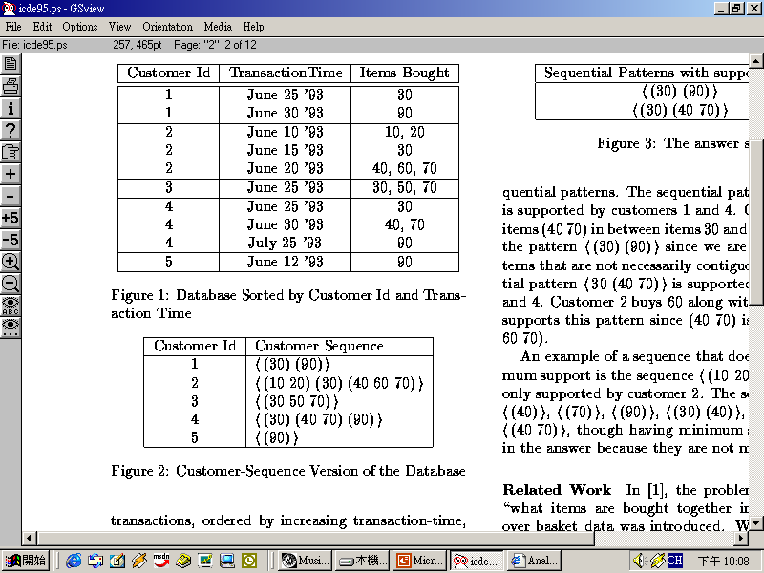
Example (cont.)
Sequence
3-Sequence
<(30) (90)> is supported by customer 1 and 4
<30 (40 70)> is supported by customer 2 and 4
With minimum support of 2 customers:
The large itemset (litemset):
(30), (40), (70), (40 70), (90)

Slide 16


Slide 17
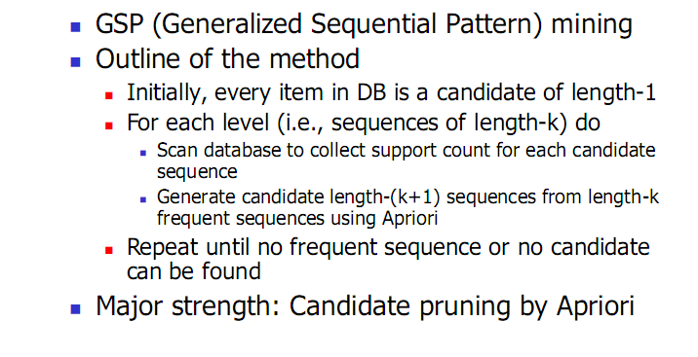
GSP算法

Slide 18
GSP算法
Five phases
  Sort phase
  Large itemset phase
  Transformation phase
  Sequence phase
  Maximal phase
Apriori

Slide 19
Sort phase
Sort the database with customer-id as the major key and transaction-time as the minor key

Slide 20
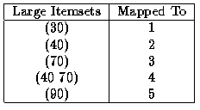
Litemset phase
Find the large itemset.
Itemsets mapping
Reason: 可把litemset当作一个整体对待。比较两个litemsets是否相等用的时间是恒定的，在判断某个序列是否包含于另一个序列时可以省时间。

Slide 21
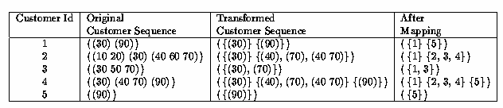
Transformation phase
Deleting non-large itemsets
Mapping large itemsets to integers

Slide 22
Sequence phase
Use the set of litemsets to find the large sequence (frequent sequence).

Slide 23
Maximal phase
Find the maximum sequences among the set of large sequences.
In some algorithms, this phase is combined with the sequence phase.

Slide 24
Maximal phase
Algorithm:
  S the set of all large sequences
  n the length of the longest sequence
for (k = n; k > 1; k--) do
foreach k-sequence s_{k} do
Delete from S all subsequences of s_{k}

Slide 25
AprioriAll算法
The basic method to mine sequential patterns
Based on the Apriori algorithm.
Count all the large sequences, including non-maximal sequences.
Use Apriori-generate function to generate candidate sequence.

Slide 26
Apriori Candidate Generation
generate candidates for pass using only the large sequences found in the previous pass and then makes a pass over the data to find their support.

Slide 27
Apriori Candidate Generation
Algorithm:
  L_{k-1} the set of all large (k-1)-sequences
  C_{k} the set of candidate k-sequences
Join Phase:
insert into C_{k}
select p.litemset₁, p.litemset₂,…, p.litemset_{k-1}, q.litemset_{k-1}
from L_{k-1} p, L_{k-1} q
where p.litemset₁=q.litemset₁,…, p.litemset_{k-2}=q.litemset_{k-2};
Prung Phase:
forall sequences c∈C_{k} do
forall (k-1)-subsequences s of c do
if (s∉L_{k-1}) then
delete c from C_{k;}

Slide 28
Example
关联规则 与 序列模式 生成候选集时的区别
  join 序列模式需要关注顺序
  例如，有如下三条序列
  <(10) (20)>
  200 <(20) (10)>
  200 <(20) (10)>
  假设minsupp=1，(10) (20)都是litemset, 分别map为1，2
  则生成C2时需要同时包含<12>和<21>
  可以发现，序列<(10) (20)>和<(20) (10)>都是所需要的序列
  模式。如果join时不考虑顺序的话，将丢掉<(20) (10)>。

Slide 29
AprioriAll (cont.)
L₁ = {large 1-sequences}; // Result of litemset phase
for ( k=2; L_{k-1}≠Φ; k++) do
begin
C_{k} = New candidate generate from L_{k-1}
foreach customer-sequence c in the database do
Increment the count of all candidates in C_{k} that are contained in c
L_{k} = Candidates in C_{k} with minimum support.
End
Answer=Maximal Sequences in L_{k};

Slide 30
Example
关联规则 与 序列模式 对itmeset计数时的区别
  如果相同的项目集合在同一个序列里出现多次的话，只记一次
  例如，有如下三条序列
  100 <(10) (20) (10)>
  200 <(20)>
  200 <(20) (30)>
  假设minsuff=2，则 (20)是litemset, 而（10）只能算出现了
  一次，因而不是litemset.

Slide 31
Apriori Candidate Generation
Example: (Customer Sequences)
<{1 5}{2}{3}{4}>
<{1}{3}{4}{3 5}>
<{1}{2}{3}{4}>
<{1}{3}{5}>
<{4}{5}>
With minimum set to 25%
next step: find the large 1-sequences

Slide 32
Example
Large 1-Sequence
<{1 5}{2}{3}{4}>
<{1}{3}{4}{3 5}>
<{1}{2}{3}{4}>
<{1}{3}{5}>
<{4}{5}>
Sequence | Support
<1>
<2>
<3>
<4>
<5>
4
2
4
4
4
next step: find the large 2-sequences

Slide 33
Example
join
<12> <21> <13> <31> <14> <41> <15> <51>
<23> <32> <24> <42> <25> <52>
<34> <43> <35> <53>
<45> <54>
prung
<12> <21> <13> <31> <14> <41> <15> <51>
<23> <32> <24> <42> <25> <52>
<34> <43> <35> <53>
<45> <54>
L₂
L₁
Sequence | Support
<1 2> | 2
<1 3> | 4
<1 4> | 3
<1 5> | 3
<2 3> | 2
<2 4> | 2
<3 4> | 3
<3 5> | 2
<4 5> | 2
Sequence | Support
<1> | 4
<2> | 2
<3> | 4
<4> | 4
<5> | 4
<{1 5}{2}{3}{4}>
<{1}{3}{4}{3 5}>
<{1}{2}{3}{4}>
<{1}{3}{5}>
<{4}{5}>

Slide 34
L₂
prung
join
<123> <132> <124> <142> <125> <152> <134> <143> <135> <153> <145> <154>
<234> <243>
<345> <354>
<123> <132> <124> <142> <125> <152> <134> <143> <135> <153> <145> <154>
<234> <243>
<345> <354>
<1 2> | 2
<1 3> | 4
<1 4> | 3
<1 5> | 3
<2 3> | 2
<2 4> | 2
<3 4> | 3
<3 5> | 2
<4 5> | 2
L₃
<1 2 3> | 2
<1 2 4> | 2
<1 3 4> | 3
<1 3 5> | 2
<2 3 4> | 2
<{1 5}{2}{3}{4}>
<{1}{3}{4}{3 5}>
<{1}{2}{3}{4}>
<{1}{3}{5}>
<{4}{5}>

Slide 35
L₃
join
<1 2 3> | 2
<1 2 4> | 2
<1 3 4> | 3
<1 3 5> | 2
<2 3 4> | 2
L₄
prung
<1234> <1243>
<1345> <1354>
1234
<1 2 3 4> | 2
<{1 5}{2}{3}{4}>
<{1}{3}{4}{3 5}>
<{1}{2}{3}{4}>
<{1}{3}{5}>
<{4}{5}>

Slide 36
Example
Find the maximal large sequences
Sequence | Support
<1> | 4
<2> | 2
<3> | 4
<4> | 4
<5> | 2
Sequence | Support
<1 2> | 2
<1 3> | 4
<1 4> | 3
<1 5> | 3
<2 3> | 2
<2 4> | 2
<3 4> | 3
<3 5> | 2
<4 5> | 2
Sequence | Support
<1 2 3> | 2
<1 2 4> | 2
<1 3 4> | 3
<1 3 5> | 2
<2 3 4> | 2
Sequence | Support
<1 2 3 4> | 2

Slide 37
judgment
Waste too much time in counting
non-maximal sequence, which is
impossible to be a sequential pattern.

Slide 38
AprioriSome
It generates candidates for a pass using only the large sequences found in the previous pass.
Divided into 2 phase:
forward vs. backward
Advantage:
Reduce counting time wasted in counting non-maximal ones.

Slide 39
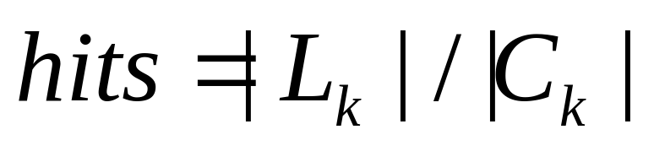
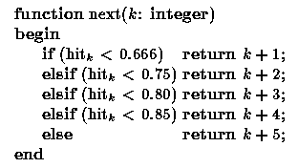
Next function

Slide 40
AprioriSome (cont.)
//Forward Phase
L₁ = {Large 1-sequences}; // Result of the litemset phase
C₁ = L₁; // so that we have a nice loop condition
Last =1; // we last counted C_{last}
for (k=2; C_{k-1}≠φ and L_{last}≠φ;k++) do
begin
if (L_{k-1} known) then
C_{k}=New candidates generated from L_{k-1};
Else
C_{k} =New candidates generated from C_{k-1};
if (k==next(last)) then begin
Foreach customer-sequence c in the database do
Increment the count of all candidates in C_{k} that are contained in c
L_{k}=Candidates in C_{k} with minimum support.
Last=k;
end
end

Slide 41
AprioriSome (cont.)
//Backward Phase
for (k--; k>=1; k-- ) do
if (L_{k} was not determined in the forward phase) then begin
Delete all sequences in C_{k} contained in some L_{i}, i>k;
foreach customer-sequence c in D_{T} do
Increment the count of all candidates in C_{k} that are contained in c.
L_{k}=Candidates in C_{k} with minimum support.
end
else begin // L_{k} already known
Delete all sequences in L_{k} contained in some L_{i}, i>k;
end
end
Answer=U_{k}L_{k};

Slide 42
Example - AprioriSome
C_{k} | L_{k}
C₁ | L₁ | f(k)=2k
C₂
L₂
C₃
L₃
C₄
L₄
C₅
---

Slide 43
So far, we covered
 | Read-based | Write-based | Point-based
Association Mining | Apriori[AgSr94] | VIPER[SHSB00] FPGrowth [HaPe00]
Sub-Graph Mining | AGM[PKDD’00] FSG[ICDM’01] | Mofa[ICDM’02] gSpan[ICDM’02]
Sequential Pattern Discovery | GSP[AgSr96] | PrefixSpan [PHPC01]
Iceberg Cube | Apriori[AgSr94] |  | BUC[BeRa99], H-cubing [HPDW01]

Slide 44
References
[AgSr94] R. Agrawal, R. Srikant, “Fast Algorithms for Mining Association Rules”, Proc. of the 20th Int'l Conference on Very Large Databases, Santiago, Chile, Sept. 1994.
[AgSr96] R. Srikant, R. Agrawal: "Mining Sequential Patterns: Generalizations and Performance Improvements", to appear in Proc. of the Fifth Int'l Conference on Extending Database Technulogy (EDBT), Avignon, France, March 1996.
[BeRa99] Kevin S. Beyer and Raghu Ramakrishnan. “Bottom-Up Computation of Sparse and Iceberg CUBEs”. In Proceedings of the ACM SIGMOD International Conference on Management of Data, pages 359-370, June 1999.
[HPDW01] J. Han, J. Pei, G. Dong, and K. Wang, “Efficient Computation of Iceberg Cubes with Complex Measures”, Proc. 2001 ACM-SIGMOD Int. Conf. on Management of Data (SIGMOD'01), Santa Barbara, CA, May 2001.
[HPY00] J. Han, J. Pei, and Y. Yin, `` Mining Frequent Patterns without Candidate Generation'',, Proc. 2000 ACM-SIGMOD Int. Conf. on Management of Data (SIGMOD'00), Dallas, TX, May 2000.
[HaPe00] J. Han and J. Pei ``Mining Frequent Patterns by Pattern-Growth: Methodology and Implications '', ACM SIGKDD Explorations (Special Issue on Scaleble Data Mining Algorithms), 2(2), December 2000.
[PHPC01] J. Pei, J. Han, H. Pinto, Q. Chen, U. Dayal, and M.-C. Hsu, “ PrefixSpan: Mining Sequential Patterns Efficiently by Prefix-Projected Pattern Growth'', Proc. 2001 Int. Conf. on Data Engineering (ICDE'01), Heidelberg, Germany, April 2001.

Slide 45
References
[SHSB00] P.Shenoy, J. Haritsa, S. Sudarshan, G. Bhalotia, M. Bawa, D. “Turbo-Charging Vertical Mining of Large Database.” Proc. 2000 ACM-SIGMOD Int. Conf. on Management of Data (SIGMOD'00), Dallas, TX, May 2000.
[Zaki98] Mohammed J. Zaki, “Efficient Enumeration of Frequent Sequences”, 7th International Conference on Information and Knowledge Management, pp 68-75, Washington DC, November 1998.
[Zaki00] Mohammed J. Zaki, “Scalable Algorithms for Association Mining”, in IEEE Transactions on Knowledge and Data Engineering, Vol. 12, No. 3, pp 372-390, May/June 2000.
[Zaki01] Mohammed J. Zaki, “SPADE: An Efficient Algorithm for Mining Frequent Sequences”, in Machine Learning Journal, special issue on Unsupervised Learning (Doug Fisher, ed.), pp 31-60, Vol. 42 Nos. 1/2, Jan/Feb 2001.

